Slide 1
Recruiting Timelines: What’s Going On?
And How to Prepare for it?

Slide 2
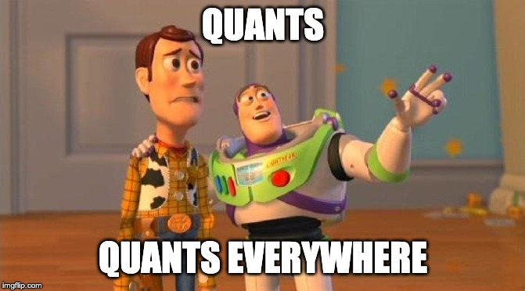

Slide 3












Slide 4
What is buy-side quant?
Buy side firms: analyzing data to help portfolio managers make profitable investment decisions
Work tends to be technical and analytical in nature, sometimes not directly finance-related
Focuses on creative solutions to complicated problems that haven’t been discovered by other firms
Important to understand that not every project will be successful- need to be good with coping with failure
Sample tasks that you could do include (non-exhaustive):
How can I predict a stock’s price from search term data?
How can I predict the stock prices of utility stocks by analyzing temperature data?
How can I predict Walmart’s future revenue based on credit card transactions?
Buy-side firms have become increasingly interested with alternative data (ie, data that is hard to get or has not been used to model a generic problem). Data cleaning skills are extremely important.

Slide 5
What skills do I need for buy-side quant?
Buy-side quant (both research and trading) involves applications of the following:
Advanced programming techniques, with some knowledge of data structures and algorithms (working knowledge of Python/SQL/Java at )
Statistical literacy (fitting regressions, interpreting regression results)
Fundamental knowledge of AI/ML
Probability
Linear algebra background (matrix multiplication)
Don’t worry if you don’t have these skills… this is not fundamental to breaking into the buy-side, especially as a first or second year!
We’ll also be holding small primers on many of these topics in the future- stay tuned!

Slide 6
Quick Plug for the Listserv
Email Stephanie Hockman (shockman@amherst.edu) and get on the Careers in Finance distribution list!
Even though many of the opportunities are geared towards investment banking/S&T, she provides tips about fit questions (which are still applicable) and about current events (which everyone should be on top of!)

Slide 7
Opportunities Available
**BUY SIDE OPPORTUNITIES ARE SIGNIFICANTLY HARDER TO GET THAN THE SELL SIDE***
DE Shaw: Applications are open continuously, year round but plan to apply as quickly as possible!
Quant Analyst Position
Also have less quant opportunities: Fundamental Research intern/Generalist intern
Jane Street: Applications for their quantitative trading/research roles are open
Two Sigma: Reach out to Toby Schwed to learn more about their quant programs
Point72: select opportunities should still be available, but require thorough investigation of their website
Akuna Capital: they’re posting jobs on Handshake and based in Chicago- definitely give it a look!

Slide 8
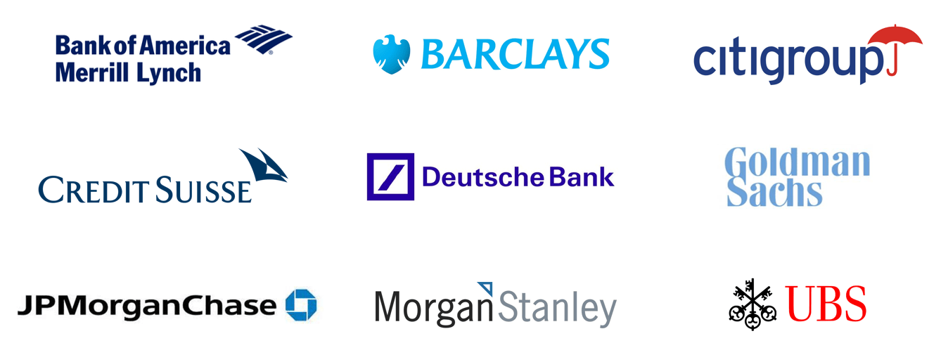
Note that other banks DO exist though!

Slide 9
What is sell-side quant?
Sell-side quant opportunities are work done as a service to your firm’s clients.
Typical tasks that you could do include:
Pricing complex derivatives
Managing risk in a portfolio
Analyzing what’s happening in the industry and using your research to make an investment decision
Writing reports on transactions
Making algorithms for managing risk more efficient
Sell side quant opportunities are often found inside of a firm’s S&T department, so express an interest in S&T if you’re interested!

Slide 10
Sell-side Quant Opportunities
**Sell side quant opportunities are much easier to get than buy side quant opportunities**
(Most) big name firms have exploratory events that give you a leg up in the recruiting process for junior summer
Goldman Sachs Undergraduate Camp (deadline Jan 6)
Barclays Sophmore Springboard Program (program is in April, deadline in Jan)
Citi Women’s Mentorship Program / Early Identification Program
Goldman Sachs Engineering: resembles “buy side” opportunities
J.P. Morgan Markets - etrading: check out S&T positions!
B&P Paribas- check Handshake
BAML Global Technology & Operations

Slide 11
List of Companies: https://www.wallstreetoasis.com/wso-company-database
Search on LinkedIn/Google

Slide 12
What to Do?

Slide 13
A Few Steps to Follow
Resume building
Coursework
Research experience
Competitions and projects
Awards
Interview prep
Networking (get your foot in the door)

Slide 14
Courses at Amherst:
Math/Stats:
MATH 211 Multivariable calculus
MATH 271/272 Linear Algebra
STAT 135 Intro + 230 Intermediate Stats
STAT 231 Data Science
MATH/STAT 360 Probability
MATH/STAT 370 Theoretical Statistics
Computer Science:
COSC 111/112 Intro + COSC 211 Data Structures + COSC 311 Algorithms
COSC 247 Machine Learning
COSC 223 Probability for Computing
There are always good classes at UMass!

Slide 15
Other AC Courses that might be useful:
Physics:
PHYS 230 Statistical Mechanics
PHYS 226 Signals and Noise (lab)
ASTR 200 Intro to Data Science
Economics:
ECON 420 Game Theory and Applications
ECON 361 Advanced Econometrics
ECON 265 Financial Economics
Market Design (you can find this course in the Five Colleges e.g. Smith ECO258)

Slide 16
Research, Projects and Competitions
Research:
SURF
In-semester research: contact professors!
Utilize Five-College resources
Any quantitative discipline works; publications are big pluses on resume
Projects and Competitions:
Hackathons/Datafests/Datathons: mlh.io
Citadel Data Open: check link here
Traders@MIT Competition
UChicago Midwest Trading Competition
Jane Street Electronic Trading Challenge

Slide 17
INTERVIEW PREP
Technical Questions:
Brainteasers
Mental math
Homework-type-problem-solving: take the courses!
Coding
Cracking the Coding Interview
leetcode.com
hackerrank.com
Fit Questions:
Why do you like trading
Intellectual vibrancy
Ability to work with teams
Creativity
EVERYTHING ON YOUR RESUME

Slide 18
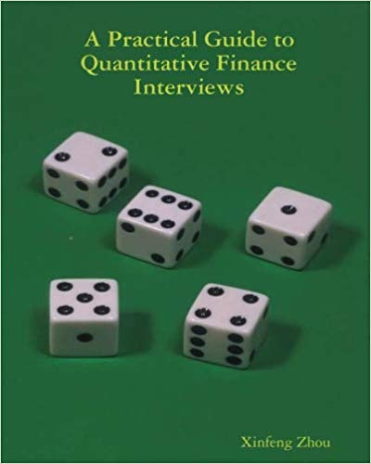


Slide 19
Other Things To Do (NOT a must):
Study away (Harvard, MIT, Columbia, Carnegie Mellon CS, NYU Courant Applied Math): LIVE in their quantitative departments, find research opportunities, use their recruiting platforms
Study Abroad: AIT Budapest, Budapest Semester in Mathematics, Oxbridge programs
Don’t do it as a semester-long vacation like you could with many other programs
Putnam Math Competition: ask the Math Dept for information
Walker Prize Competition (on-campus)

Slide 20
HAVE A SOLID FOUNDATION IN QUANTITATIVE SUBJECTS AND BE REALLY GOOD AT ONE TOPIC

Slide 21
Questions? Feedback?

